Slide 2
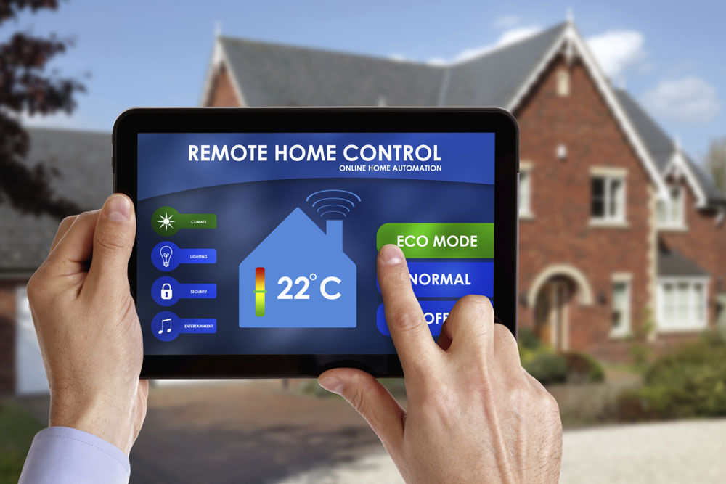
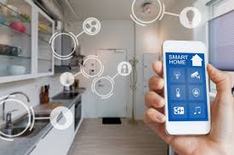
IOT BASED HOME AUTOMATION USING WEBPAGE
Presented By :
SRI RAM .N
B.PREETHAM REDDY

Slide 3
OVERVIEW
INTRODUCTION
COMPONENTS
BLOCK DIAGRAM
WORKING
APPLICATIONS
ADVANTAGES
CONCLUSION

Slide 4
INTRODUCTION
Today, technology has become an integrated part of people's lives. It has, and continues to influence many aspects of daily life .
The internet has become a common interface that many devices use in order to simplify the daily life of many peopled .
Smartphones have allowed people to connect to the internet without the need for a computer, while still offering the same functionality but through different means.

Slide 5
HOME AUTOMATION
COMPUTERIZED CONTROL OVER THE ELECTRICAL AND ELECTRONICS SYSTEMS IN A BUILDING
MOBILE HOST CONTROLLER
CLIENT MODULE COMMUNICATE WITH HOST CONTROLLER WIRELESS WITH THE HELP OF WI-FI MODULE

Slide 6
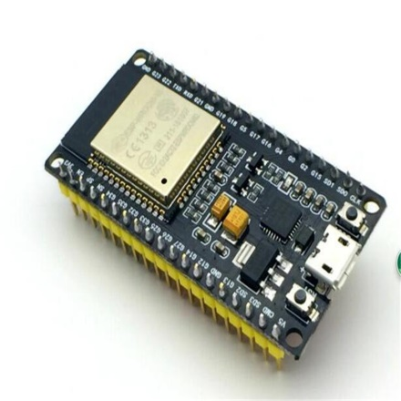
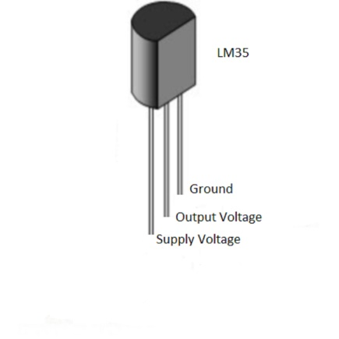

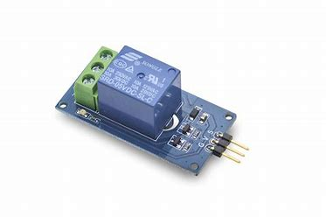
COMPONENTS
ESP32
LM35
BULB
RELAY

Slide 7
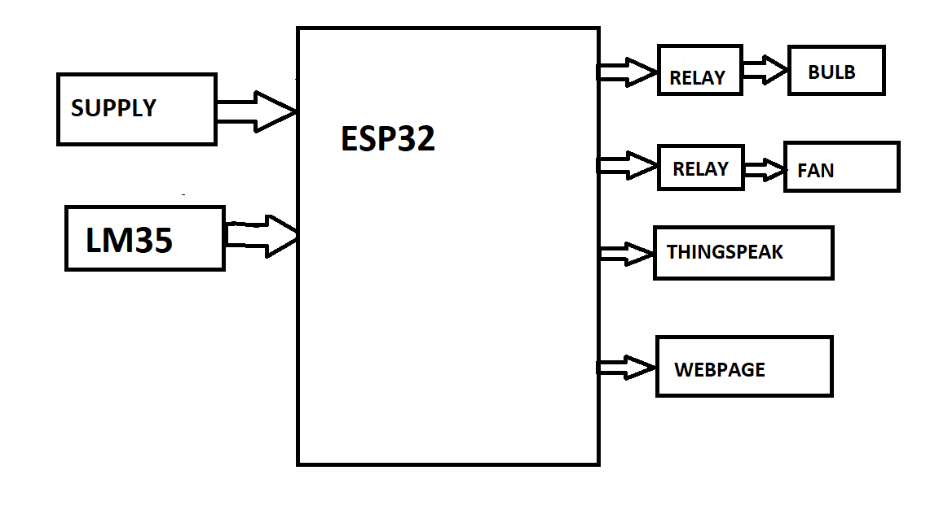
BLOCK DIAGRAM
`

Slide 8
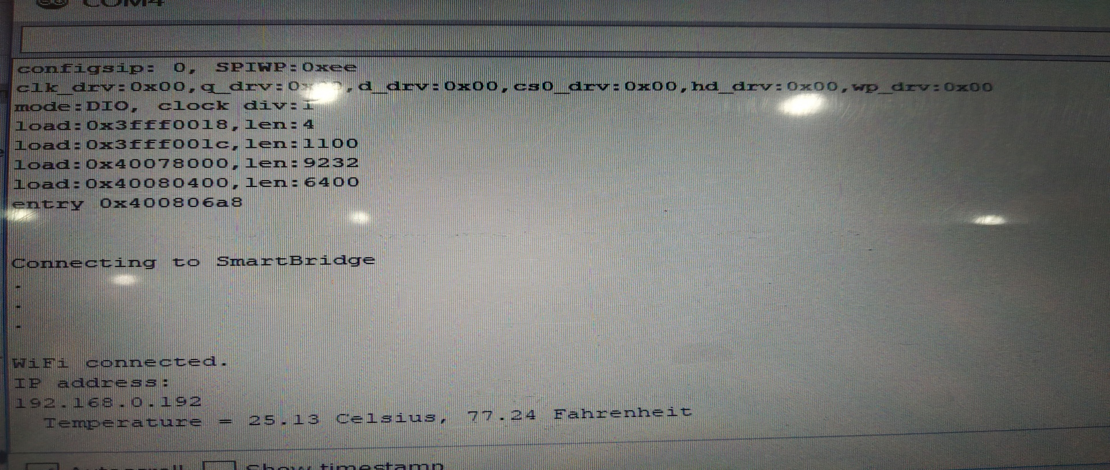
WORKING

Slide 9
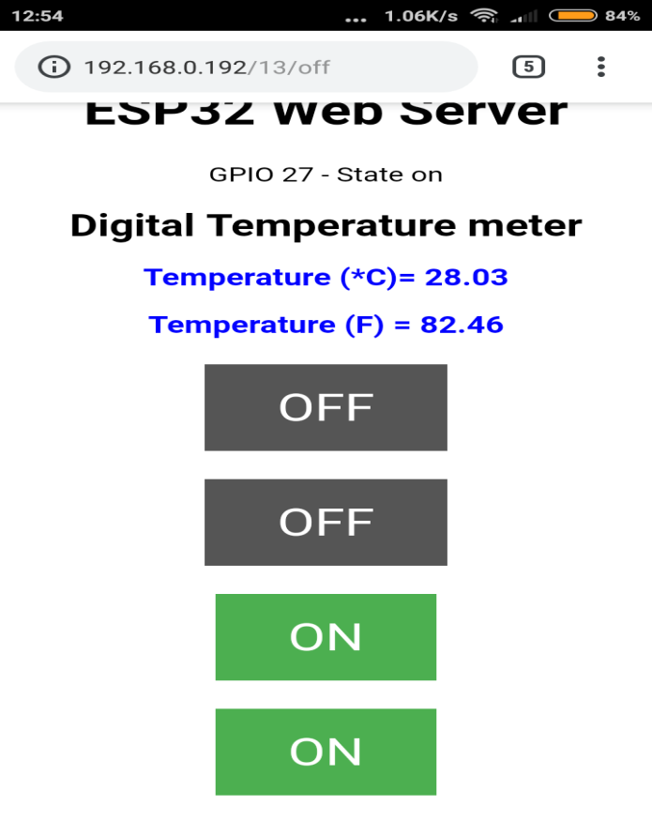
WEB PAGE

Slide 10
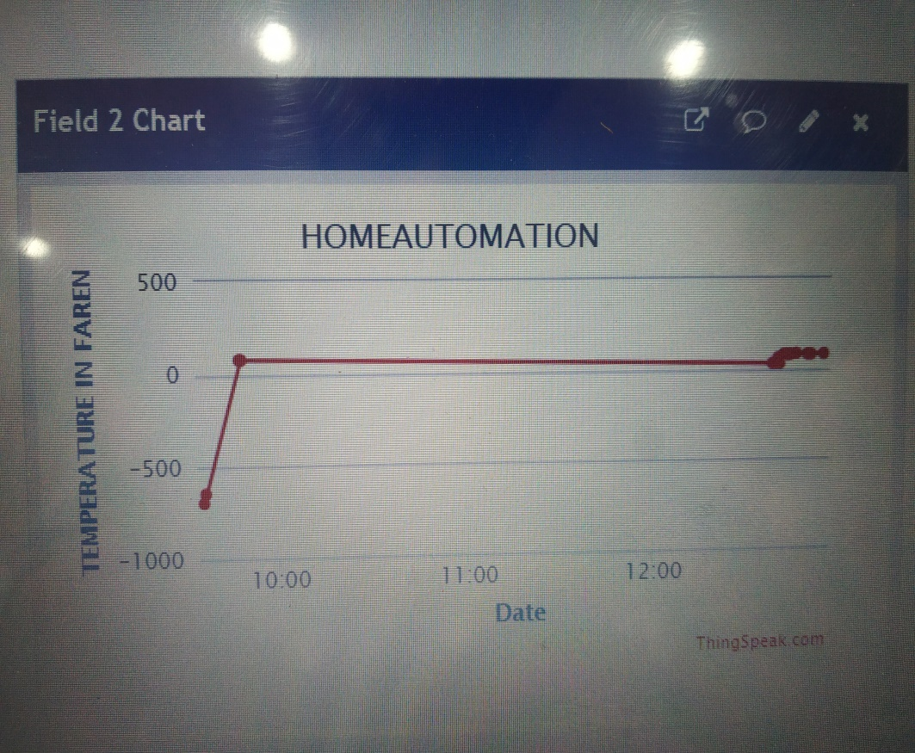
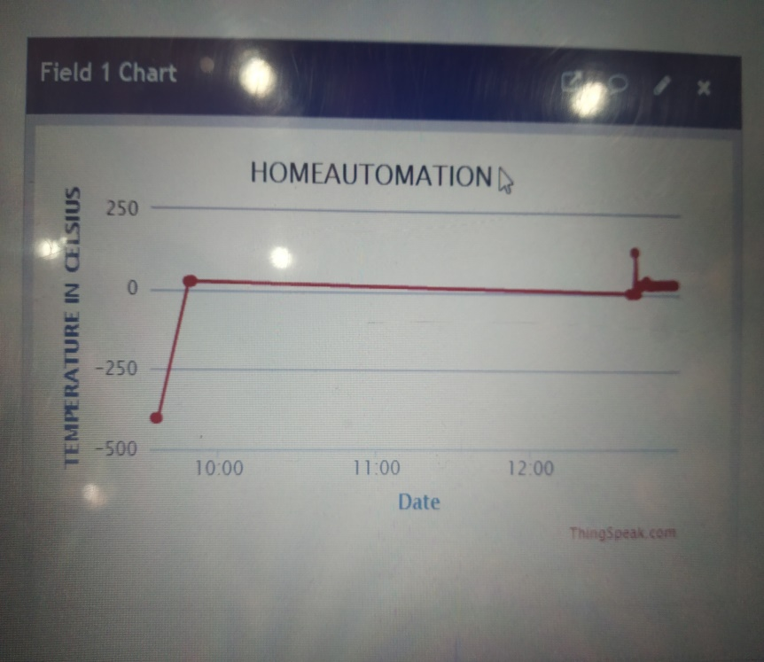
DATA CLOUD

Slide 11
ADVANTAGES
LOSS OF POWER CAN BE REDUCED
EASE OF OPERATION
MORE EFFICIENT
TIME MANAGEMENT
Home automation system with automated door locking and security cameras facilitates more security
By using a home automation system, we can save a lot of time to operate home appliances from anywhere

Slide 12
APPLICATIONS
Security systems
Smoke detection
Temperature sensors
Gas leak sensors
Motion sensors
Occupancy sensors for power saving
Light management
Blinds sensors/Auto curtains
Smart light switch
Temperature & Humidity sensors Smart meter

Slide 13
A cheap and open-source alternative to control household appliances
CONCLUSION

